Slide 1
Modern Data Warehouse
Big Data + Data Warehouse

Slide 2








Reason for a Data Lake
Data Lake
Rapid Data Innovation (Self-service, Data Experimentation)
Unstructured Data (Images, Videos)
IOT Telemetry/Data (Semi-Structured)
Streaming Data
Archive Data
Just in-case data
Structured Data (Big V)

Slide 3



The Azure Big Data landscape
Data Pipeline
Azure Data Factory
Azure Import/Export service
Processing/Analytics
Business Intelligence
>_
Azure Data Lake Analytics
Azure HDInsight
Azure
Databricks
Azure Analysis Services
Power BI
Azure CLI
Azure SDK
Ingestion
Serving/Warehouse
Azure IoT Hub
Azure event hubs
Azure SQL data warehouse
Streaming
AI/ML
Azure Cosmos DB
Kafka on Azure HDI
Landing/Storage
10 01
Azure Stream
Analytics
Azure HDInsight
Azure
Databricks
Azure ML
ML Server
Azure
Databricks
Azure Blob Storage
Azure Data Lake Store

Slide 4













Data warehousing pattern in Azure
Loading and preparing data for analysis with a data warehouse
Data Pipeline
Business Intelligence
Data factory
Azure Import/Export Service
Azure Data Box
APIs, CLI, and GUI tools
Applications
Landing/storage
Processing/Analytics
Serving/Warehouse
Logs, files, and media
(unstructured)
Azure Databricks
Data Lake Store
Azure Storage
Cosmos DB
HDInsight
Azure Data Lake Analytics
Azure SQL DW
Business and custom apps (structured)
Cosmos DB
SQL DB
AAS
Power BI
Ingestion

Slide 5


















Big Data streaming pattern with Azure
Machine learning
Azure ML Studio
R Server
Azure Databricks
(Spark ML)
Sensors and IoT
(unstructured)
Stream ingestion
Stream analytics
Real-time applications
Logs, files, and media
(unstructured)
Event hubs
IoT hub
Kafka on HDInsight
Azure Stream
Analytics
Azure Databricks
(Spark Streaming)
Storm on
HDInsight
Long-term storage
Power BI
Business/custom apps (structured)
Real-time dashboards
Data Lake Store
SQL DB
Cosmos DB
Azure Blob Storage

Slide 6




Real-time analytics pattern in Azure
Ingest
Store
Prep & train
Model & serve
Azure HDInsight
(Apache Kafka)
Data science & AI
Azure Cosmos DB
Intelligent apps
Streaming data
Azure Databricks
Power BI
Data engineering
Azure SQL Data Warehouse
Azure Analysis Services
Batch data
Azure Data Factory
Azure Data Lake Storage
Notes:
Implementing advanced analytics solutions in your organization is a four-step process.
First, you need to ingest data from a variety of data sources, including batch and streaming data.
Azure HDInsight allows you to ingest data at scale in real-time
Azure Data Factory enables you to ingest structured and unstructured batch data at scale, in addition to orchestrating your data preparation processes
Then, you need to take in and store disparate data that’s being ingested regardless of data volumes, variety, and velocity.
With Azure Blob Storage, you can build data integration pipelines that span on-premises and cloud
Next, you need to cleanse, prepare, and train your data.
Azure Databricks enables data scientists and data engineers to collaboratively build and test ML and AI models in the fastest Spark environment
Finally, you need to model and serve this prepared data to your applications, bots, and agents.
Azure Cosmos DB offers low-latency for massively scalable applications
With Azure SQL Data Warehouse, you can easily integrate with leading BI solutions, such as Power BI
<Transition>: Today, we want to focus on preparing and training advanced analytics models.

Slide 7
Azure SQL PaaS options

Slide 8
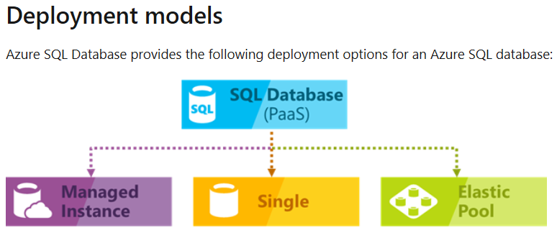
Azure SQL Database documentation
Azure SQL Database is a general-purpose relational database-as-a-service (DBaaS) based on the latest stable version of Microsoft SQL Server Database Engine. SQL Database is a high-performance, reliable, and secure cloud database that you can use to build data-driven applications and websites in the programming language of your choice, without needing to manage infrastructure. Learn how to use SQL Database with our quickstarts, tutorials, and samples.

Slide 9
Azure Big Data storage options

Slide 10
File storage requirements
Requirement | Comment
Capacity | Should be able to store terabytes or petabytes of data economically. File storage should be able to store any number of objects and associated metadata.
Performance | Should be able to store the incoming data as fast as it arrives. Should support high bandwidth, high throughput, and low-latency writes.
Multiple tiers | Should support storing data for extended periods of time— that is months or years—economically. Should have with multiple storage tiers (hot, cold, and archival).
Multiple object sizes | Objects can be stored individually—could be as small as few tens of bytes—or as data sets that create large objects—from several gigabytes to terabytes.
Replication | Should provide data replication that suits your needs for a combination of durability, bandwidth, and data governance requirements. Locally redundant storage provides the highest maximum bandwidth, with the least durability, whereas geo-redundancy options provide higher durability with possible asynchronous replication delay.

Slide 11
File storage
A side-by-side comparison of the capabilities and features
 | Azure Data Lake Store | Azure Blob Storage containers
Purpose | Optimized storage for Big Data analytics workloads | General purpose object store for a wide variety of storage scenarios
Structure | Hierarchical file system | Object store with flat namespace
API | REST API over HTTPS | REST API over HTTP/HTTPS
Analytics workload performance | Optimized performance for parallel analytics workloads, high throughput and IOPS | Not optimized for analytics workloads
Size limits | No limits on account sizes, file sizes, or number of files | Max 500 TB per account and 4.75 TB per file
Geo-redundancy | Locally-redundant (multiple copies of data in one Azure region) | Locally redundant (LRS), globally redundant (GRS), and read-access globally redundant (RA-GRS). See Azure Storage replication for more information
Service state | Generally available | Generally available
Regional availability | Some regions | All regions

Slide 12
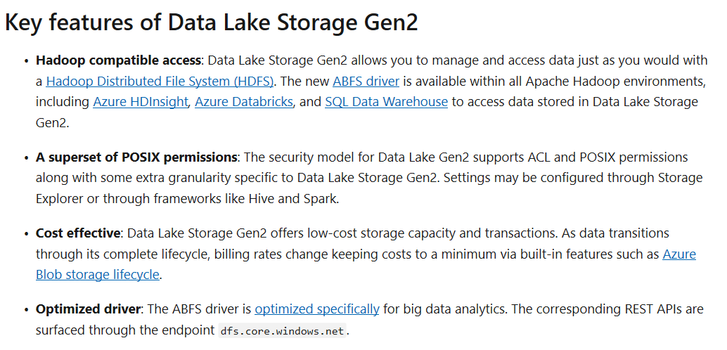
Azure Data Lake Storage

Slide 13
Azure SQL Data Warehouse

Slide 14
Azure SQL Data Warehouse
SQL DW Overview > Overview
Best in class
price-performance
Industry-leading security
Intelligent workload management
Data flexibility
Developer productivity
Up to 94% less expensive than competitors
Defense-in-depth security and 99.9% financially backed availability SLA
Separation of compute and storage
Prioritize resources for the most valuable workloads
Query directly over the Data Lake
Support for structured and semi-structured data
Enterprise class application lifecycle management
Classified as Microsoft Confidential

Slide 15
SQL DW Fundamentals
Control
Control
Connection and tool endpoint. Coordinates compute activity.
Engine
DMS
SQL DB
Compute
Handles query processing, ability to scale up/down
Compute
Compute
Compute
Compute
DMS
DMS
DMS
DMS
SQL DB
SQL DB
SQL DB
SQL DB
Dist_DB_1
Dist_DB_2
Dist_DB_15
Dist_DB_16
Dist_DB_17
Dist_DB_30
Dist_DB_31
Dist_DB_32
Dist_DB_45
Dist_DB_46
Dist_DB_47
Dist_DB_60
DMS: Data Movement Services
Coordinates data movement between nodes
…
…
…
…
Azure Blob Storage
Storage
Remote storage. Scales independently of compute

Slide 16


Separate compute from storage
SQL
Control
Compute
Premium Storage

Slide 17
Independently scale compute
SQL
Control
Compute
Premium Storage

Slide 18
Pause and resume workload
SQL
Control
Compute
Premium Storage

Slide 19
Query Execution
Result
Query
SQL
Control
Compute
Premium Storage

Slide 20
Data Loading

Slide 21
WHAT does PolyBase do?
Load Data
Use external tables as an ETL tool to cleanse data before loading
Age-out Data
Age data to HDFS or Azure Storage as ‘cold’ but query-able.
Interactively Query
Analyze relational and non-relational data together
HOW does it do it?
Imposes structure on semi-structured data
Define external tables over data
Reads/Writes Hadoop file formats
Text, CSV, RCFILE, ORC, Parquet, Avro, etc.
Parallelizes Data Transfers
Direct loads to service compute nodes

Slide 22
Parallel Load
Compute Node
Azure Storage Blob (ASB)
DMS
Bridge
Control Node
Compute Node
DMS
DMS
Bridge
Compute Node
DMS
Bridge

